Slide 1
Relational Database Management System

Slide 2
What is RDBMS
RDBMS stands for Relational Database Management Systems..
All modern database management systems like SQL, MS SQL Server, IBM DB2, ORACLE, My-SQL and Microsoft Access are based on RDBMS.
It is called Relational Data Base Management System (RDBMS) because it is based on relational model introduced by E.F. Codd.

Slide 3
How it works
Data is represented in terms of tuples (rows) in RDBMS.
Relational database is most commonly used database. It contains number of tables and each table has its own primary key.
Due to a collection of organized set of tables, data can be accessed easily in RDBMS.

Slide 4
Brief History of RDBMS
During 1970 to 1972, E.F. Codd published a paper to propose the use of relational database model.
RDBMS is originally based on that E.F. Codd's relational model invention.

Slide 5
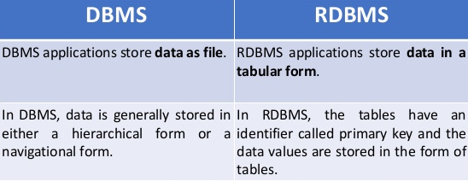
Difference Between DBMS and RDBMS
Although DBMS and RDBMS both are used to store information in physical database but there are some remarkable differences between them.
The main differences between DBMS and RDBMS are given below

Slide 6
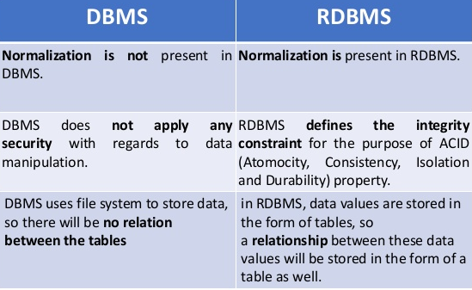
Difference Between DBMS and RDBMS

Slide 7
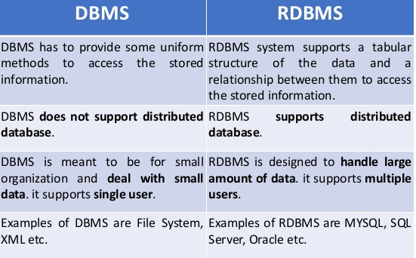
Difference Between DBMS and RDBMS

Slide 8
What is a table?
The RDBMS database uses tables to store data. A table is a collection of related data entries and contains rows and columns to store data.
A table is the simplest example of data storage in RDBMS.
A table is also considered as convenient representation of relations. But a table can have duplicate tuples while a true relation cannot have duplicate tuples.

Slide 9
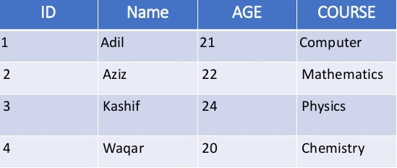
What is a table?
Let’s see the example of Student’s table.

Slide 10
What is a field?
Every table is broken up into smaller entities called fields. The fields in the Student table consist of ID, Name, AGE and Course.
A field is a column in a table that is designed to maintain specific information about every record in the table.

Slide 11
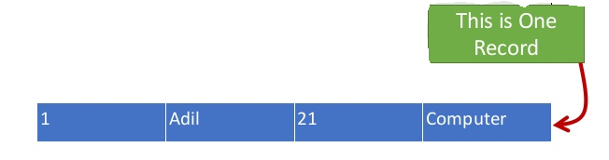
What is a Row or Record?
A row of a table is also called record.
It contains the specific information of each individual entry in the table. It is a horizontal entity in the table.
For Example: The Previous Student’s table contains 4 records
Let's see one record/row in the table.

Slide 12
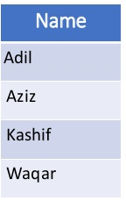
What is a Column ?
A column is a vertical entity in the table which contains all information associated with a specific field in a table.
For example: “Name" is a column in the Previous table which contains all information about student's name.

Slide 13
What is NULL Value?
A NULL value in a table is a value in a field that appears to be blank, which means a field with a NULL value is a field with no value.
It is very important to understand that a NULL value is different than a zero value or a field that contains spaces. A field with a NULL value is one that has been left blank during record creation.

Slide 14
Database Keys
Keys are very important part of Relational database. They are used to establish and identify relation between tables. They also ensure that each record within a table can be uniquely identified by combination of one or more fields within a table.
Key is a set of one or more columns whose combined values are unique among all occurrences in a given table.
A key is the relational means of specifying uniqueness. In patient database, a patient number could be used as a key field to uniquely identify each patient's record in the doctors' patient file. The patient's name could not be a key field as there may be more than one patient with the same name. There must be at least one key field in each table.

Slide 15
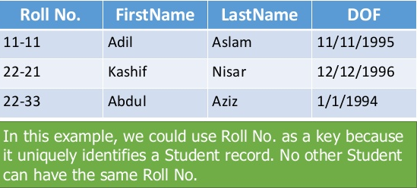
Keys in Database
A key is a field or set of fields whose values uniquely identify.
Consider the Following Student table

Slide 16
Types Of Keys
Super Key
Candidate Key
Primary Key
Alternate key
Composite Key
Foreign Key
Secondary or Alternative key
Non-prime Attribute

Slide 17
Super Key
Super key is a set of one or more than one keys that can be used to identify a record uniquely in a table.
Example : Primary key, Unique key, Alternate key are subset of Super Keys.

Slide 18
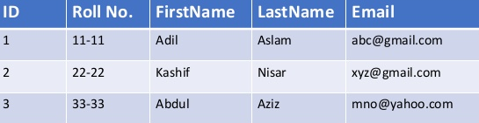
Candidate Key
Candidate keys are defined as the set of fields from which primary key can be selected.
A Candidate Key is a set of one or more fields/columns that can identify a record uniquely in a table. There can be multiple Candidate Keys in one table. Each Candidate Key can work as Primary Key.
Example: In below table (ID , Roll No. and Email are candidate keys, because both can uniquely identify the employee record in the table)

Slide 19
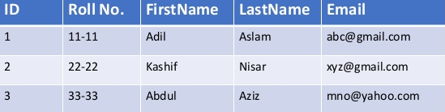
Primary Key
Primary key is a candidate key that is most appropriate to become main key of the table.
Primary key is a set of one or more fields/columns of a table that uniquely identify a record in database table.
It can not accept null, duplicate values.
Only one Candidate Key can be Primary Key.
Here ID is Primary Key.

Slide 20
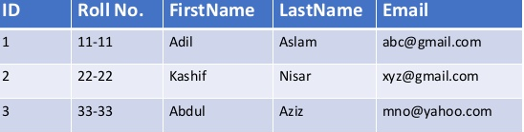
Alternate Key
A Alternate key is a key that can be work as a primary key. Basically it is a candidate key that currently is not primary key.
Example: In below Table Roll No. and Email becomes Alternate Keys when we define ID as Primary Key.

Slide 21
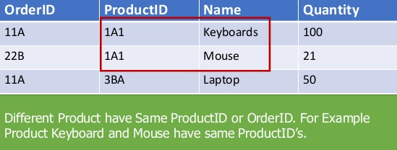
Composite/Compound Key
It is possible in some tables that no one column can act as a primary key, and that a combination of columns are required to create the key. This is known as a compound key.
Key that consist of two or more attributes that uniquely identify an entity occurrence is called Composite key.
Consider this table:

Slide 22
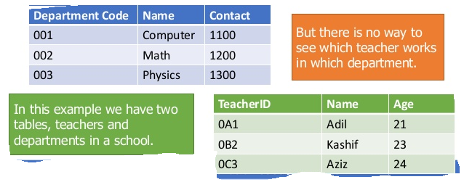
Foreign Key
Foreign Key is a field in database table that is Primary key in another table. It can accept multiple null, duplicate values.
A foreign key is a column which is added to one table to create a relationship with another table.

Slide 23
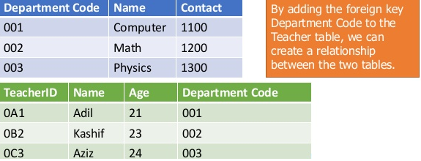
Foreign Key
Foreign Key is a field in database table that is Primary key in another table. It can accept multiple null, duplicate values.
A foreign key is a column which is added to one table to create a relationship with another table.

Slide 24
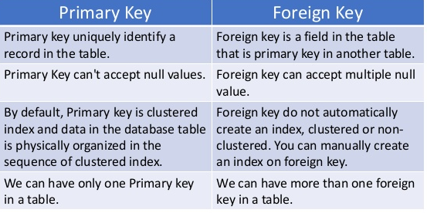
Difference Between Primary Key and Foreign Key

Slide 25
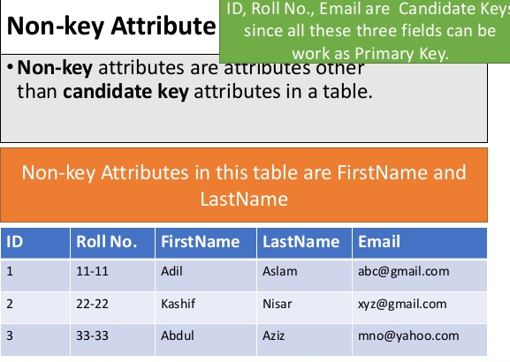

Slide 26
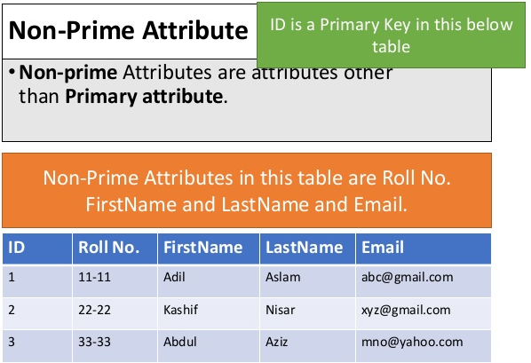

Slide 27
Normalization

Slide 28
Normalization of Database
Database Normalization is a technique of organizing the data in the database. Normalization is a systematic approach of decomposing tables to eliminate data redundancy and undesirable characteristics like Insertion, Update and Deletion Anomalies. It is a multi-step process that puts data into tabular form by removing duplicated data from the relation tables.
Normalization is used for mainly two purpose,
Eliminating redundant (useless) data.
Ensuring data dependencies make sense i.e. data is logically stored.

Slide 29
Why do we Normalize?
To avoid redundancy (less storage space needed, and data is consistent)
To avoid update/delete anomalies

Slide 30
Anomalies in DBMS
There are three types of anomalies that occur when the database is not normalized.
These are – Insertion, update and deletion anomaly.
Let’s take an example to understand this.

Slide 31
Anomalies in DBMS
Example:
Suppose a manufacturing company stores the employee details in a table named employee that has four attributes:
emp_id for storing employee’s id,
emp_name for storing employee’s name,
emp_address for storing employee’s address and
emp_dept for storing the department details in which the employee works.

Slide 32
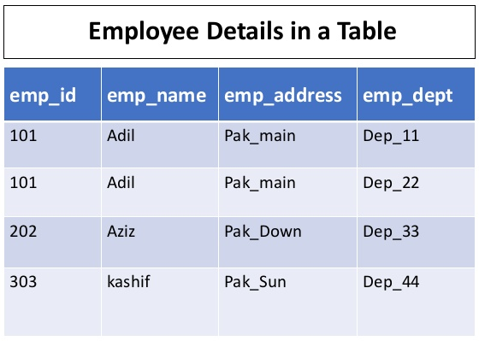

Slide 33
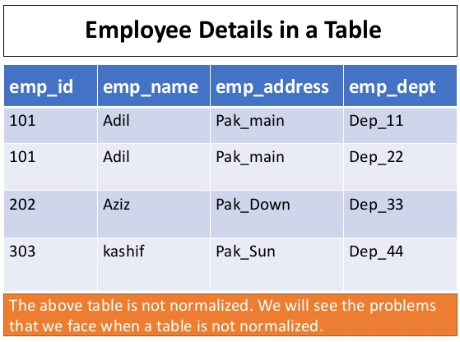

Slide 34
Update Anomaly
In the previous table we have two rows for employee Adil as he belongs to two departments of the company.
If we want to update the address of Adil then we have to update the same in two rows or the data will become inconsistent.
If somehow, the correct address gets updated in one department but not in other then as per the database, Adil would be having two different addresses, which is not correct and would lead to inconsistent data.

Slide 35
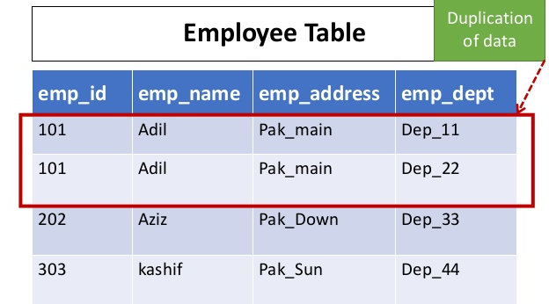

Slide 36
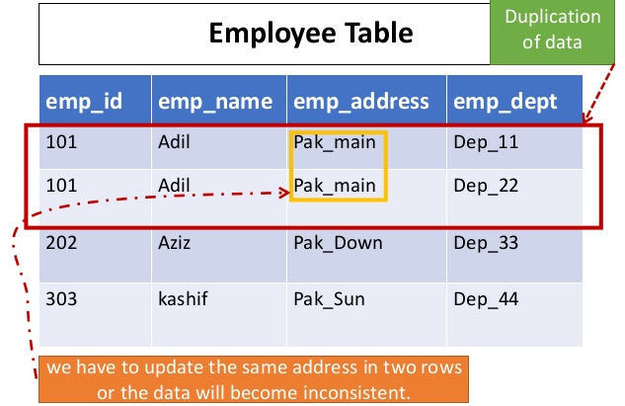

Slide 37
Insert Anomaly
Suppose a new employee Waqas the company, who is under training and currently not assigned to any department then we would not be able to insert the data into the table if emp_dept field doesn’t allow nulls.
There, leading to Insertion Anomaly.

Slide 38

Delete Anomaly
Suppose, if at a point of time the company closes the department Dep_33 then deleting the rows that are having emp_dept as Dep_33 would also delete the information of employee Aziz since he is assigned only to this department.

Slide 39
Normalization
Here are the most commonly used normal forms:
First normal form (1NF)
Second normal form (2NF)
Third normal form (3NF)
Boyce & Codd normal form (BCNF)

Slide 40
First Normal Form (1NF)
As per the rule of first normal form, an attribute (column) of a table cannot hold multiple values.
It should hold only atomic values.
(“no repeating groups”)
Example: Suppose a company wants to store the names and contact details of its employees. It creates a table that looks like this

Slide 41
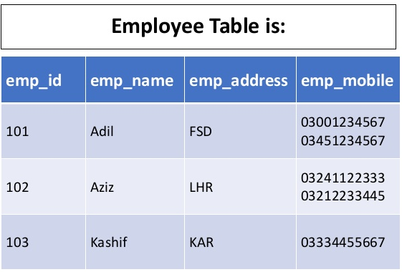

Slide 42
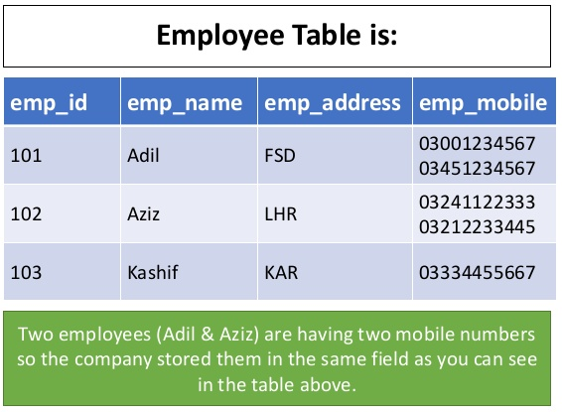

Slide 43
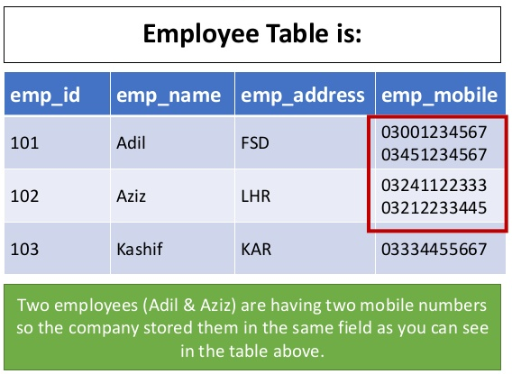

Slide 44
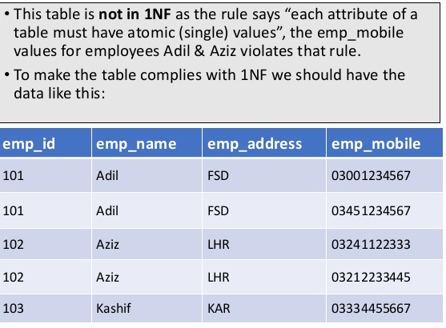

Slide 45
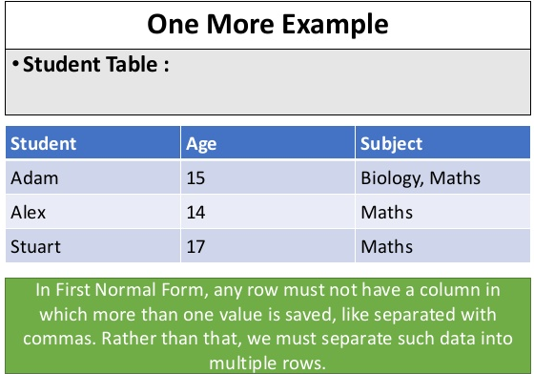

Slide 46
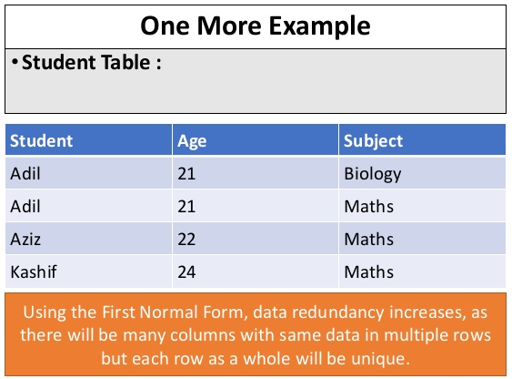

Slide 47
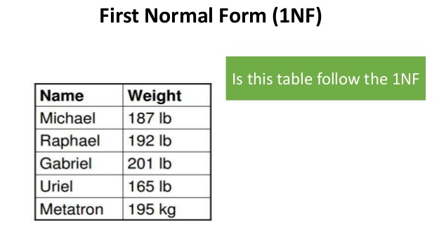

Slide 48
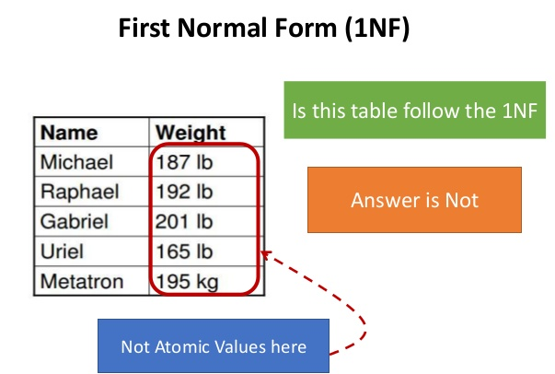

Slide 49
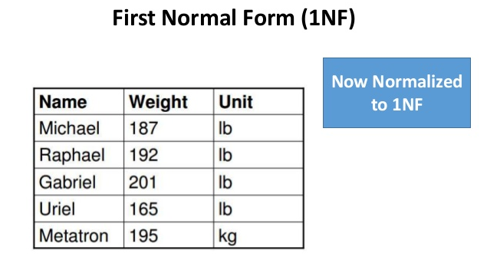

Slide 50
Second Normal Form (2NF)
As per the Second Normal Form there must not be any partial dependency of any column on primary key.
It means that for a table that has concatenated primary key, each column in the table that is not part of the primary key must depend upon the entire concatenated key for its existence.
If any column depends only on one part of the concatenated key, then the table fails Second normal form.

Slide 51
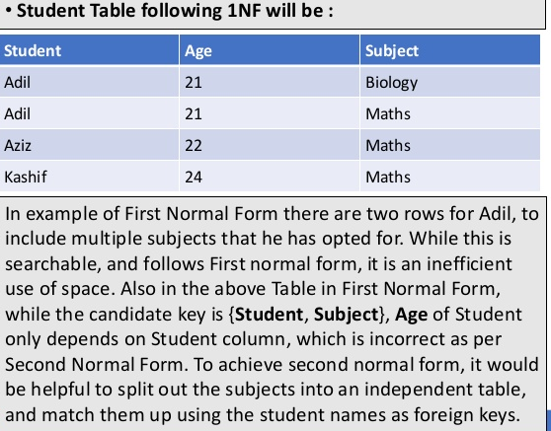

Slide 52
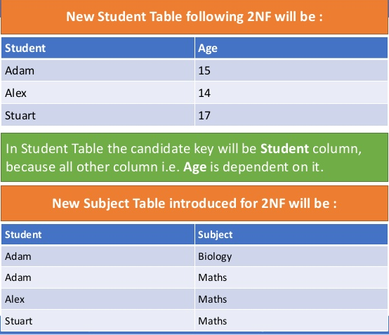

Slide 53
Second Normal Form (2NF)
In Subject Table the candidate key will be {Student, Subject} column. Now, both the above tables qualifies for Second Normal Form and will never suffer from Update Anomalies.
Although there are a few complex cases in which table in Second Normal Form suffers Update Anomalies, and to handle those scenarios Third Normal Form is there.

Slide 54
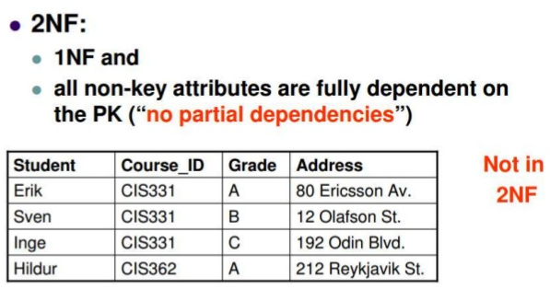
Second Normal Form (2NF)

Slide 55
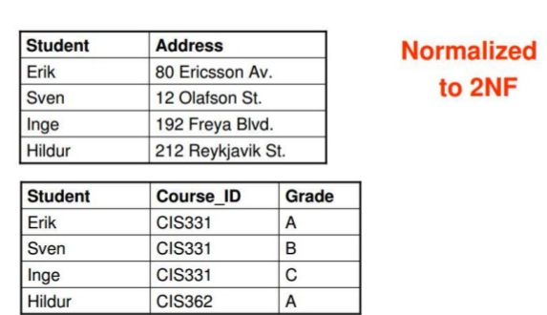
Second Normal Form (2NF)

Slide 56
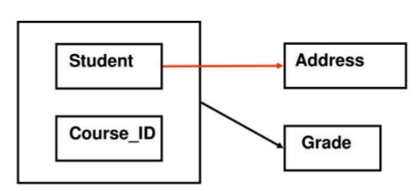
Second Normal Form (2NF)

Slide 57
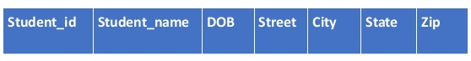
Third Normal Form (3NF)
Third Normal form applies that every non-prime attribute of table must be dependent on primary key, or we can say that, there should not be the case that a non-prime attribute is determined by another non-prime attribute.
So this transitive functional dependency should be removed from the table and also the table must be in Second Normal form. For example, consider a table with following fields.

Slide 58
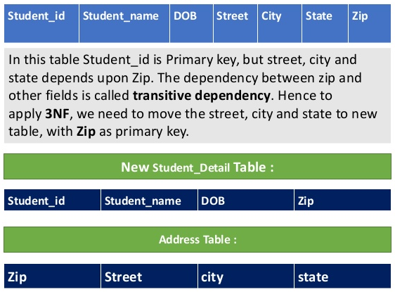

Slide 59
Third Normal Form (3NF)
The advantage of removing transitive dependency are :
Amount of data duplication is reduced.
Data integrity achieved.

Slide 60
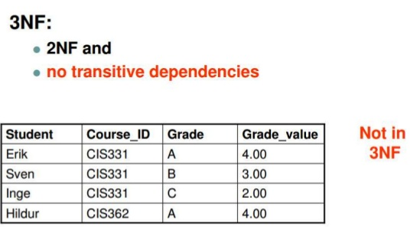
Third Normal Form (3NF)

Slide 61
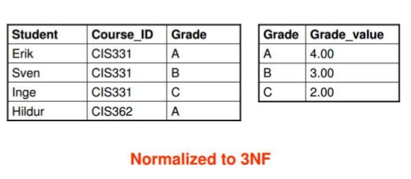
Third Normal Form (3NF)

Slide 62
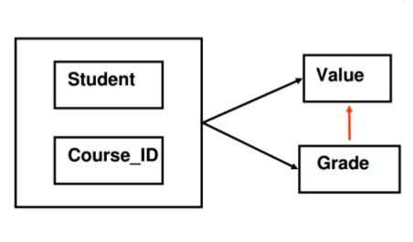
Third Normal Form (3NF)

Slide 63
Normalization : Overview
1NF (all attributes are atomic)
2NF (no partial dependencies)
3NF (no transitive dependencies)

Slide 64
ACID

Slide 65
ACID
The ACID model of database design is one of the oldest and most important concepts of database theory.
It sets forward four goals that every database management system must strive to achieve:
Atomicity
consistency
isolation
durability.
A relational database that fails to meet any of these four goals cannot be considered reliable. A database that possesses these characteristics is considered ACID-compliant.

Slide 66
ACID, Defined
Each of the four ACID attributes follow well-defined standards:
Atomicity states that database modifications must follow an “all or nothing” rule. Each transaction is said to be atomic.
If one part of the transaction fails, the entire transaction fails. It is critical that the database management system maintains the atomic nature of transactions in spite of any DBMS, operating system, or hardware failure.

Slide 67
ACID, Defined
Consistency states that only valid data will be written to the database.
If, for some reason, a transaction is executed that violates the database’s consistency rules, the entire transaction will be rolled back, and the database will be restored to a state consistent with those rules.
On the other hand, if a transaction successfully executes, it will take the database from one state that is consistent with the rules to another state that is also consistent with the rules.

Slide 68
ACID, Defined
Isolation requires that multiple transactions occurring at the same time not impact each other’s execution.
For example, if Joe issues a transaction against a database at the same time that Mary issues a different transaction, both transactions should operate on the database in an isolated manner. The database should either perform Joe’s entire transaction before executing Mary’s, or vice-versa. This prevents Joe’s transaction from reading intermediate data produced as a side effect of part of Mary’s transaction that will not eventually be committed to the database.
Note that the isolation property does not ensure which transaction will execute first—merely that transactions will not interfere with each other

Slide 69
ACID, Defined
Durability ensures that any transaction committed to the database will not be lost.
Durability is ensured through the use of database backups and transaction logs that facilitate the restoration of committed transactions in spite of any subsequent software or hardware failures.

Slide 70
Entity Relationship Diagram (ERD)

Slide 71
Database Model
A database can be modeled as:
a collection of entities,
relationship among entities.
Database systems are often modeled using an Entity Relationship (ER) diagram as the "blueprint" from which the actual data is stored — the output of the design phase.

Slide 72
Entity Relationship Diagram (ERD)
ER model allows us to sketch database designs
ERD is a graphical tool for modeling data.
ERD is widely used in database design
ERD is a graphical representation of the logical structure of a database
ERD is a model that identifies the concepts or entities that exist in a system and the relationships between those entities

Slide 73
Purposes of ERD
An ERD serves several purposes
The database analyst/designer gains a better understanding of the information to be contained in the database through the process of constructing the ERD.
The ERD serves as a documentation tool.
Finally, the ERD is used to communicate the logical structure of the database to users. In particular, the ERD effectively communicates the logic of the database to users.

Slide 74
Components of an ERD
An ERD typically consists of four different graphical components:
Entity
Relationship
Cardinality
Attribute

Slide 75
Classification of Relationship
Optional Relationship
An Employee may or may not be assigned to a Department
A Patient may or may not be assigned to a Bed
Mandatory Relationship
Every Course must be taught by at least one Teacher
Every mother have at least a Child

Slide 76
Cardinality Constraints
Express the number of entities to which another entity can be associated via a relationship set.
Cardinality Constraints - the number of instances of one entity that can or must be associated with each instance of another entity.
Minimum Cardinality
If zero, then optional
If one or more, then mandatory
Maximum Cardinality
The maximum number

Slide 77
Cardinality Constraints (Contd.)
For a binary relationship set the mapping cardinality must be one of the following types:
–One to one
A Manager Head one Department and vice versa
–One to many ( or many to one)
An Employee Works in one Department or One Department has many Employees
–Many to many
A Teacher Teaches many Students and A student is taught by many Teachers

Slide 78
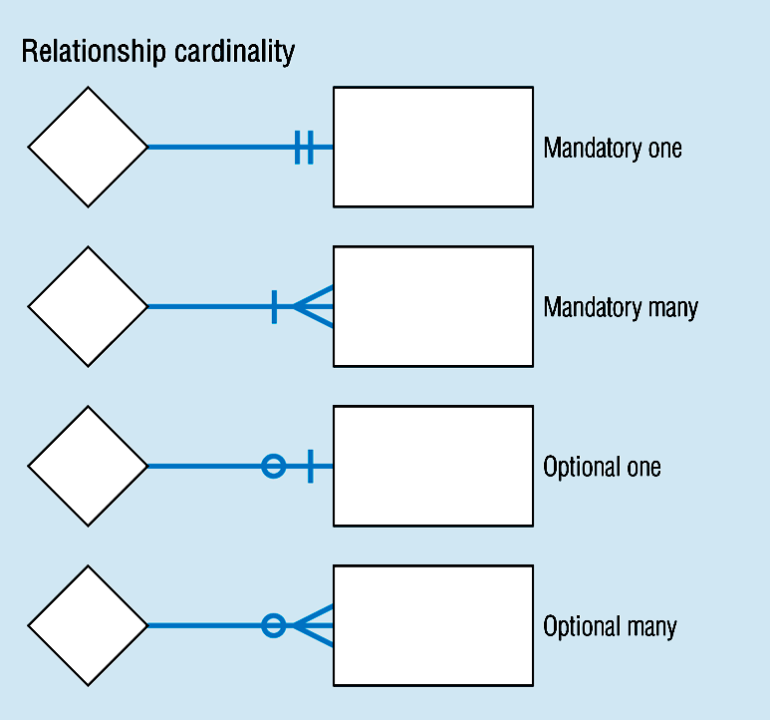
Cardinality Constraints (Contd.)

Slide 79
Cardinality Constraints Example
In our model, we wish to indicate that each school may enroll many students, or may not enroll any students at all.
We also wish to indicate that each student attends exactly one school. The following diagram indicates this optionality and cardinality:

Slide 80
Cardinality Constraints Example (Contd.)
STUDENT
Each school enrolls
Each student attends
at least zero
at least one
and at most many
and at most one
students
SCHOOL
school

Slide 81
General Steps to create an ERD
Identify the entity
Identify the entity's attributes
Identify the Primary Keys
Identify the relation between entities
Identify the Cardinality constraint
Draw the ERD
Check the ERD

Slide 82
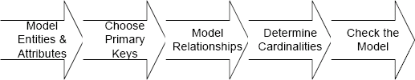
Steps in building an ERD

Slide 83
Developing an ERD
The process has ten steps:
Identify Entities
Find Relationships
Draw Rough ERD
Fill in Cardinality
Define Primary Keys
Draw Key-Based ERD
Identify Attributes
Map Attributes
Draw fully attributed ERD
Check Results

Slide 84
A Simple Example
A company has several departments. Each department has a supervisor and at least one employee. Employees must be assigned to at least one, but possibly more departments. At least one employee is assigned to a project, but an employee may be on vacation and not assigned to any projects. The important data fields are the names of the departments, projects, supervisors and employees, as well as the supervisor and employee number and a unique project number.

Slide 85
Identify entities
One approach to this is to work through the information and highlight those words which you think correspond to entities.
A
company has several departments. Each
department has a supervisor and at least one employee. Employees must be assigned to at least one, but possibly more departments. At least one employee is assigned to a project, but an employee may be on vacation and not assigned to any projects. The important data fields are the names of the departments, projects, supervisors and employees, as well as the supervisor and employee number and a unique project number.
A true entity should have more than one instance

Slide 86
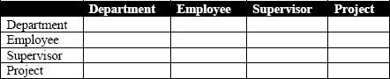
Find Relationships
Aim is to identify the associations, the connections between pairs of entities.
A simple approach to do this is using a relationship matrix (table) that has rows and columns for each of the identified entities.

Slide 87
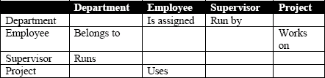
Find Relationships (Contd.)
Go through each cell and decide whether or not there is an association. For example, the first cell on the second row is used to indicate if there is a relationship between the entity "Employee" and the entity "Department".

Slide 88
Identified Relationships
Names placed in the cells are meant to capture/describe the relationships. So you can use them like this
A Department is assigned an employee
A Department is run by a supervisor
An employee belongs to a department
An employee works on a project
A supervisor runs a department
A project uses an employee

Slide 89
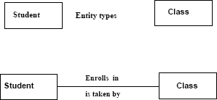
Draw Rough ERD
Draw a diagram and:
Place all the entities in rectangles
Use diamonds and lines to represent the relationships between entities.
General Examples

Slide 90
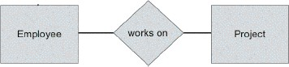
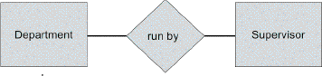
Drawing Rough ERD (Contd.)

Slide 91
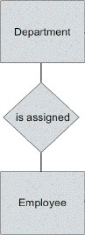
Drawing Rough ERD (Contd.)

Slide 92
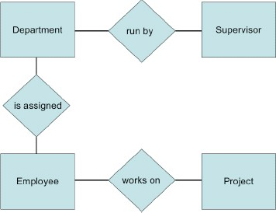
Drawing Rough ERD (Contd.)

Slide 93
Fill in Cardinality
Supervisor
Each department has one supervisor.
Department
Each supervisor has one department.
Each employee can belong to one or more departments
Employee
Each department must have one or more employees
Each project must have one or more employees
Project
Each employee can have 0 or more projects.

Slide 94
Fill in Cardinality (Contd.)
The cardinality of a relationship can only have the following values
–One and only one
–One or more
–Zero or more
–Zero or one

Slide 95
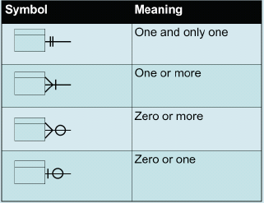
Cardinality Notation

Slide 96

Cardinality Examples
A
B
Each instance of A is related to a minimum of zero and a maximum of one instance of B
A
B
Each instance of B is related to a minimum of one and a maximum of one instance of A
A
B
Each instance of A is related to a minimum of one and a maximum of many instances of B
A
B
Each instance of B is related to a minimum of zero and a maximum of many instances of A

Slide 97
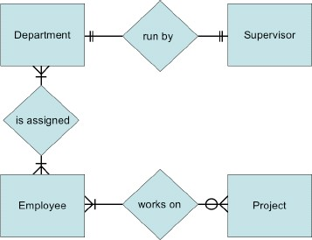
ERD with cardinality

Slide 98

Examples

Slide 99

ERD for Course Enrollment

Slide 100

ERD for Course Registration

Slide 101

Rough ERD Plus Primary Keys

Slide 102
Identify Attributes
•
In this step we try to identify and name all the attributes essential to the system we are studying without trying to match them to particular entities.
The best way to do this is to study the forms, files and reports currently kept by the users of the system and circle each data item on the paper copy.
Cross out those which will not be transferred to the new system, extraneous items such as signatures, and constant information which is the same for all instances of the form (e.g. your company name and address). The remaining circled items should represent the attributes you need. You should always verify these with your system users. (Sometimes forms or reports are out of date.)
The only attributes indicated are the names of the departments, projects, supervisors and employees, as well as the supervisor and employee NUMBER and a unique project number.
•
•
•

Slide 103
Map Attributes
For each attribute we need to match it with exactly one entity. Often it seems like an attribute should go with more than one entity (e.g. Name). In this case you need to add a modifier to the attribute name to make it unique (e.g. Customer Name, Employee Name, etc.) or determine which entity an attribute "best' describes.
If you have attributes left over without corresponding entities, you may have missed an entity and its corresponding relationships. Identify these missed entities and add them to the relationship matrix now.

Slide 104

Map Attributes (Contd.)

Slide 105

Draw Fully Attributed ERD

Slide 106
Check ERD Results
Look at your diagram from the point of view of a system owner or user. Is everything clear?
Check through the Cardinality pairs.
Also, look over the list of attributes associated with each entity to see if anything has been omitted.

